Slide 1
Find the procedure to transfer the files from one virtual machine to another virtual machine
Krishnai Kakade

Slide 2
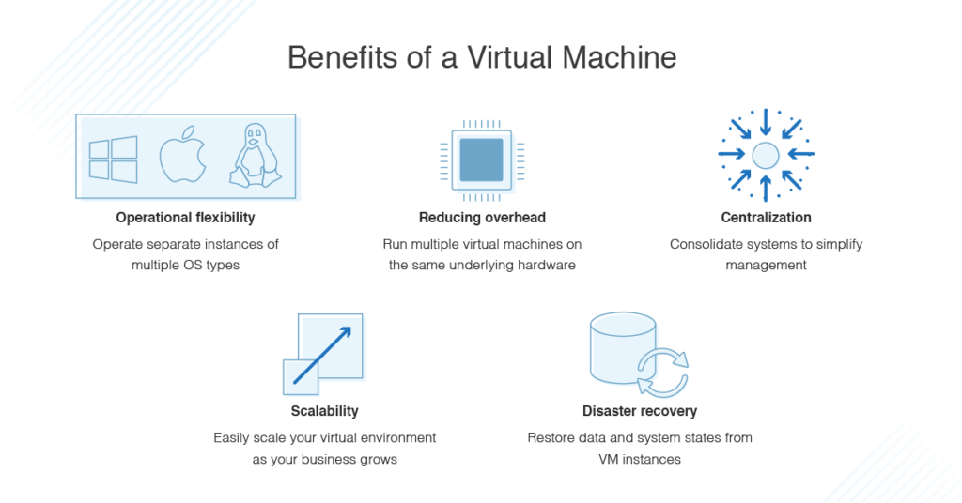
The main purpose of VMs is to operate multiple operating systems at the same time, from the same piece of hardware. Without virtualization, operating multiple systems — like Windows and Linux — would require two separate physical units.

Slide 3
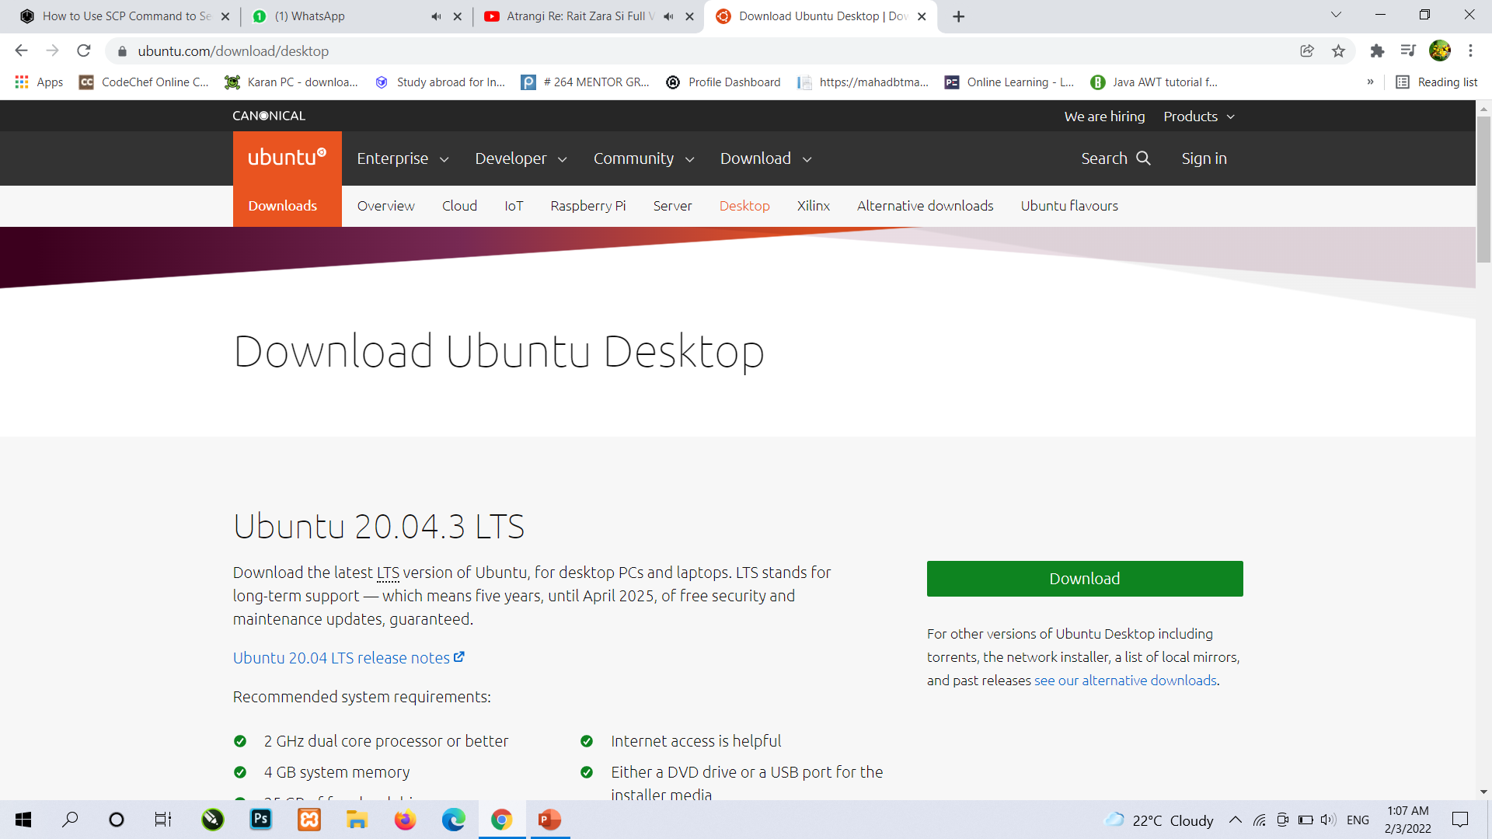
To Transfer the files from one virtual machine to another virtual machine we need to download vmware and two operating systems
https://ubuntu.com/download/desktop
Here is the official site to download ubuntu operating system

Slide 4
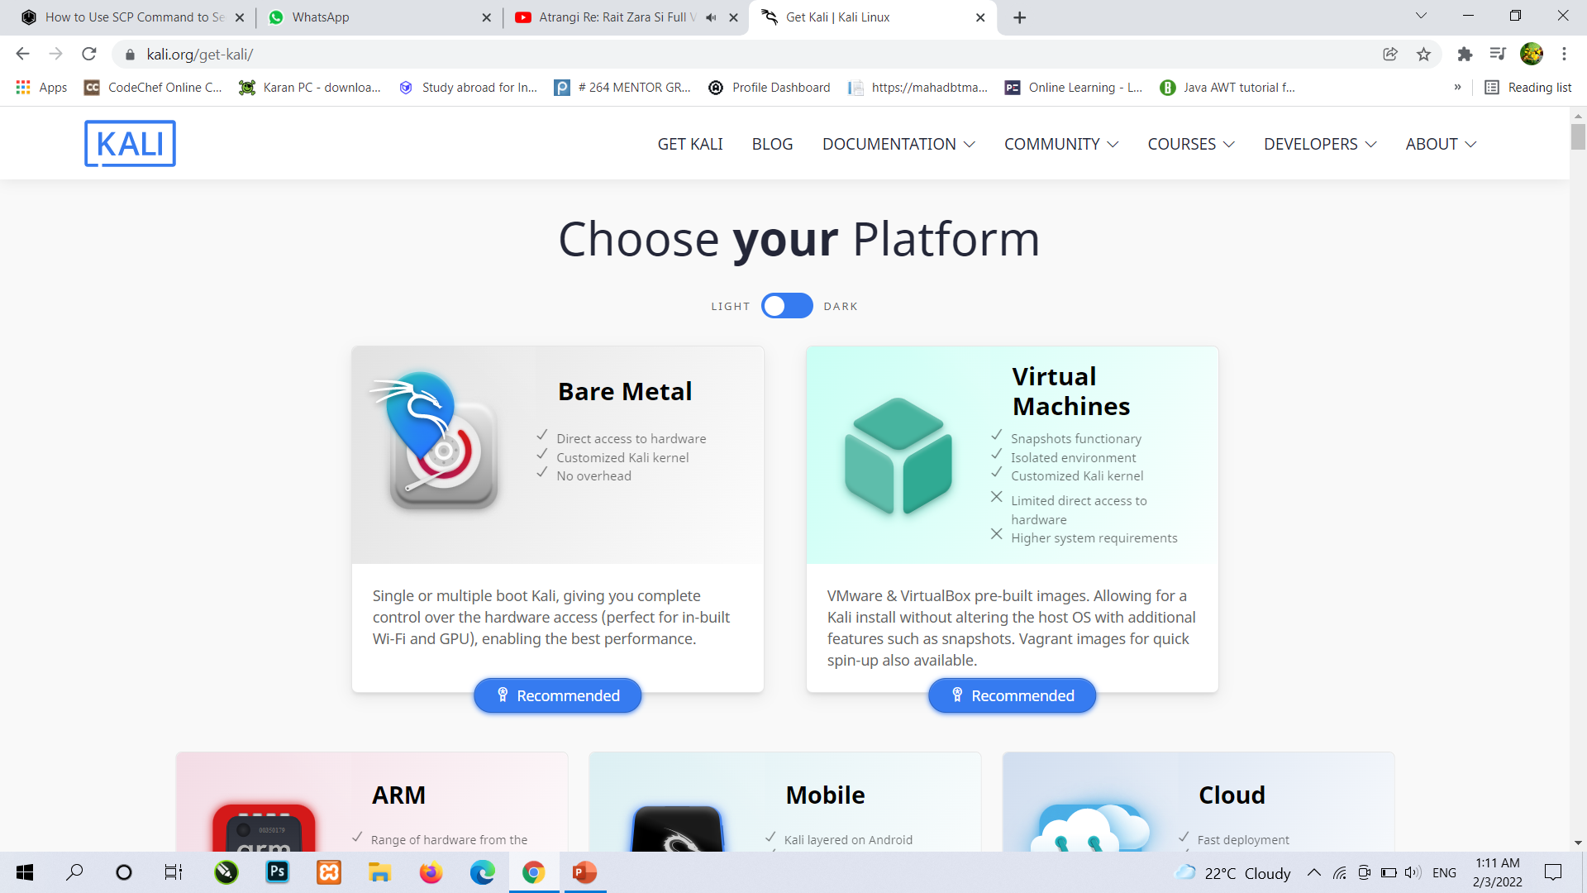
Download Kali Linux
https://www.kali.org/get-kali/
Here is the official site to download kali linux operating system

Slide 5
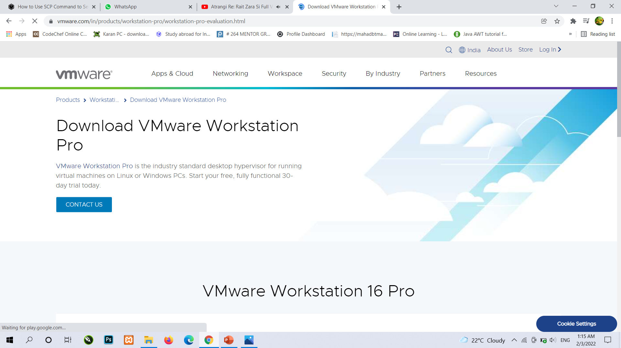
Download VMware
https://www.vmware.com/in/products/workstation-pro/workstation-pro-evaluation.html
Here is the official site to download Vmware in your system

Slide 6
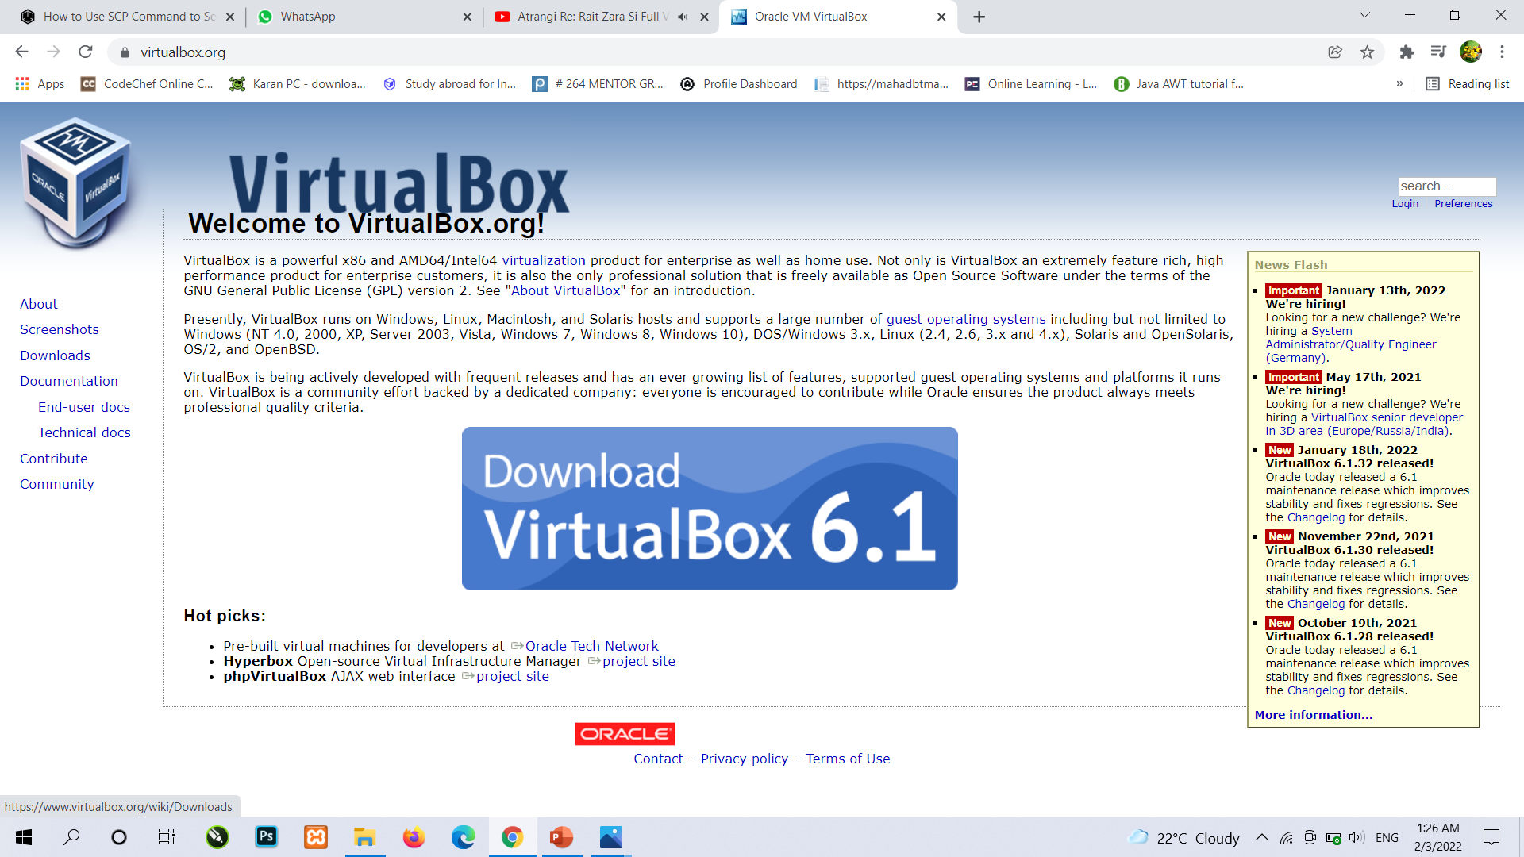
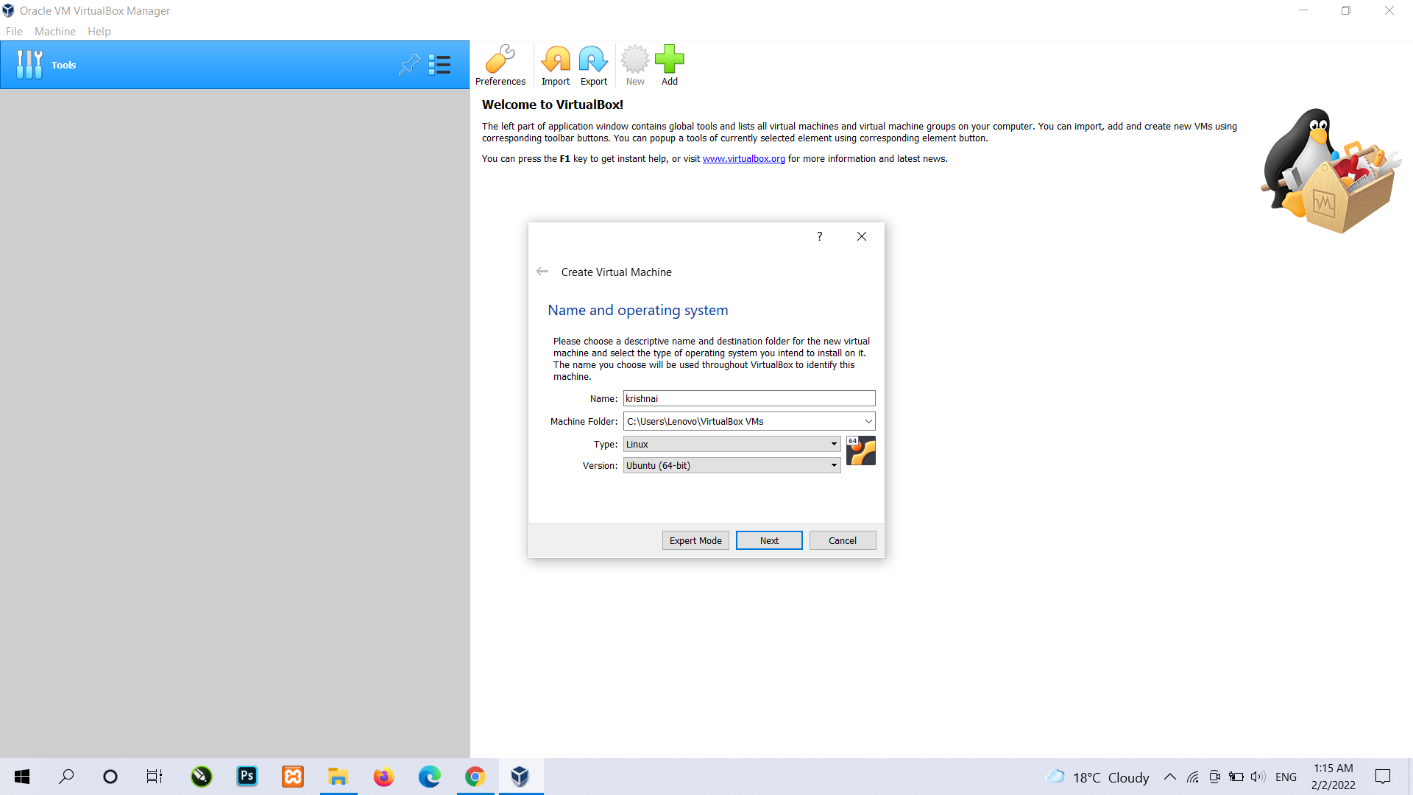
Installation of Virtual box after successfully installing virtual box then you can click on new button and create your virtual machine https://www.virtualbox.org/

Slide 7
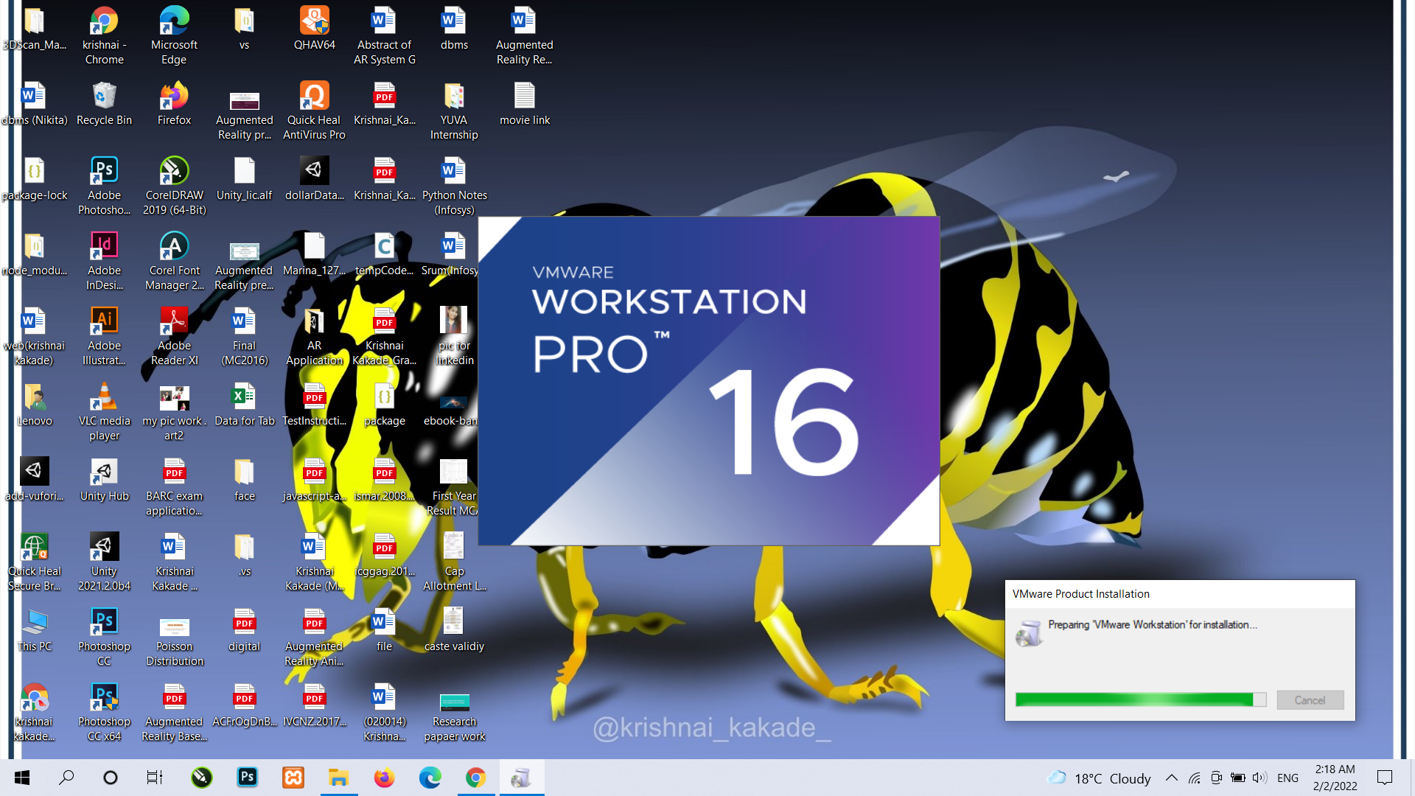
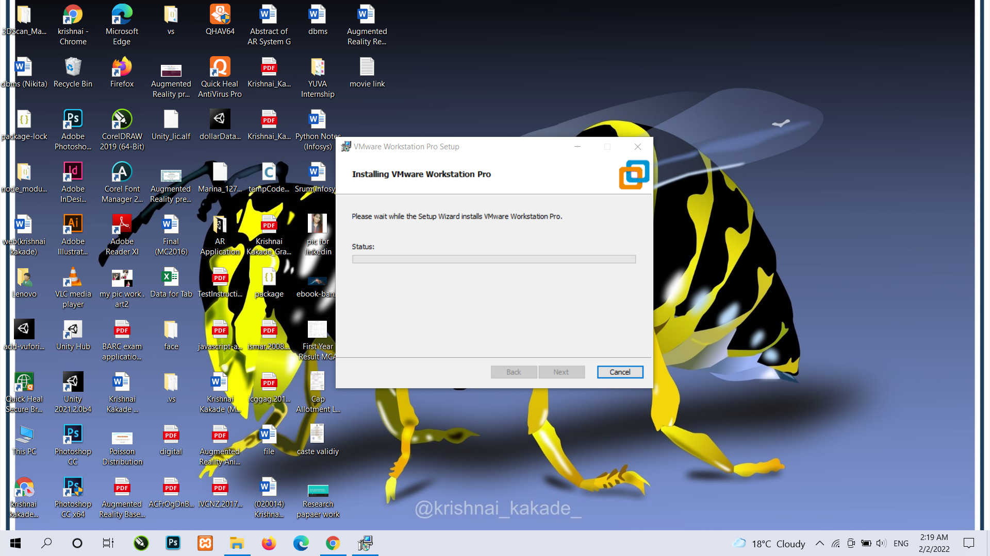
Installation of VMware you just have to click on it then it will start installing in your system

Slide 8
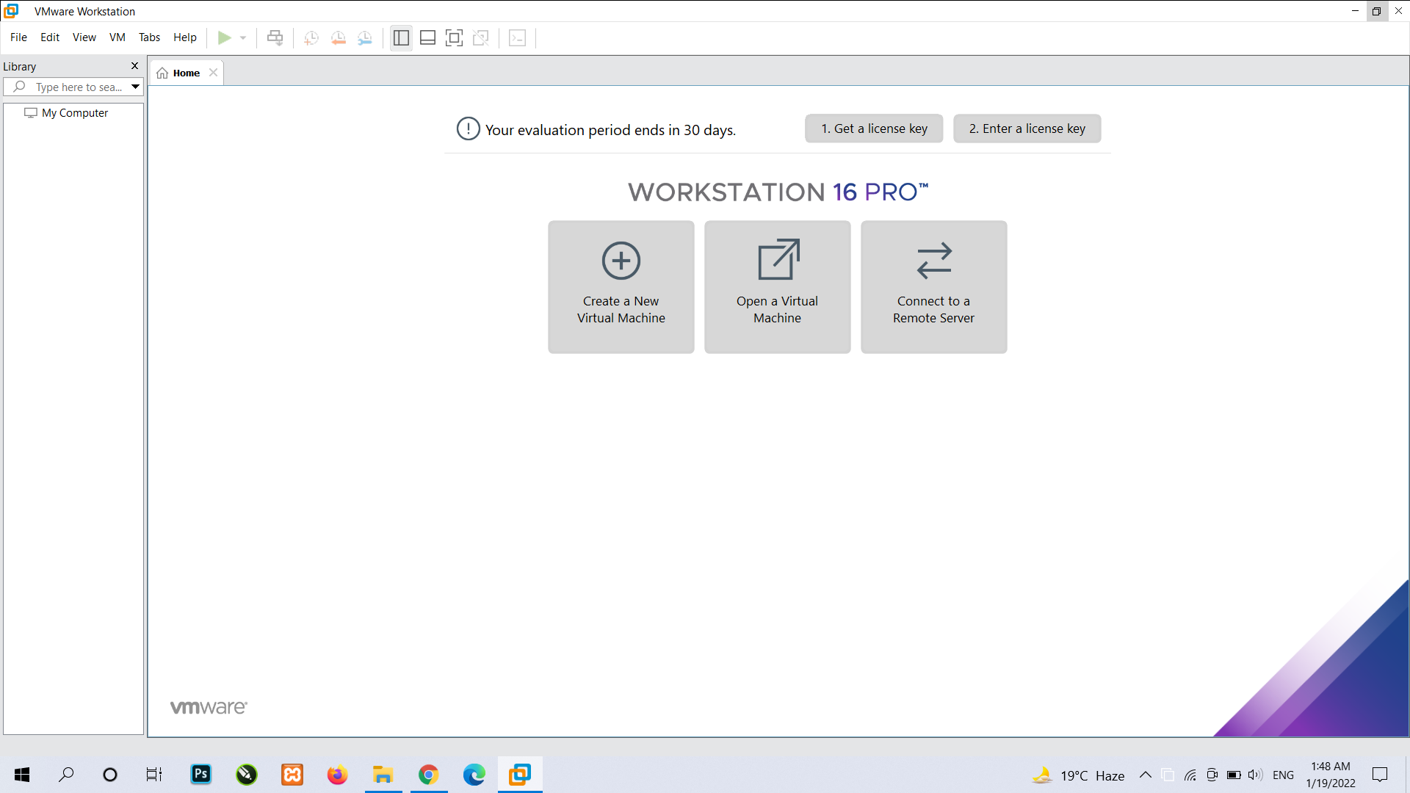
After downloading or installing Vmware we need to install both the operating system into it for that we have to click on create a new virtual machine button and add path of your operating systems file then follow other instructions

Slide 9
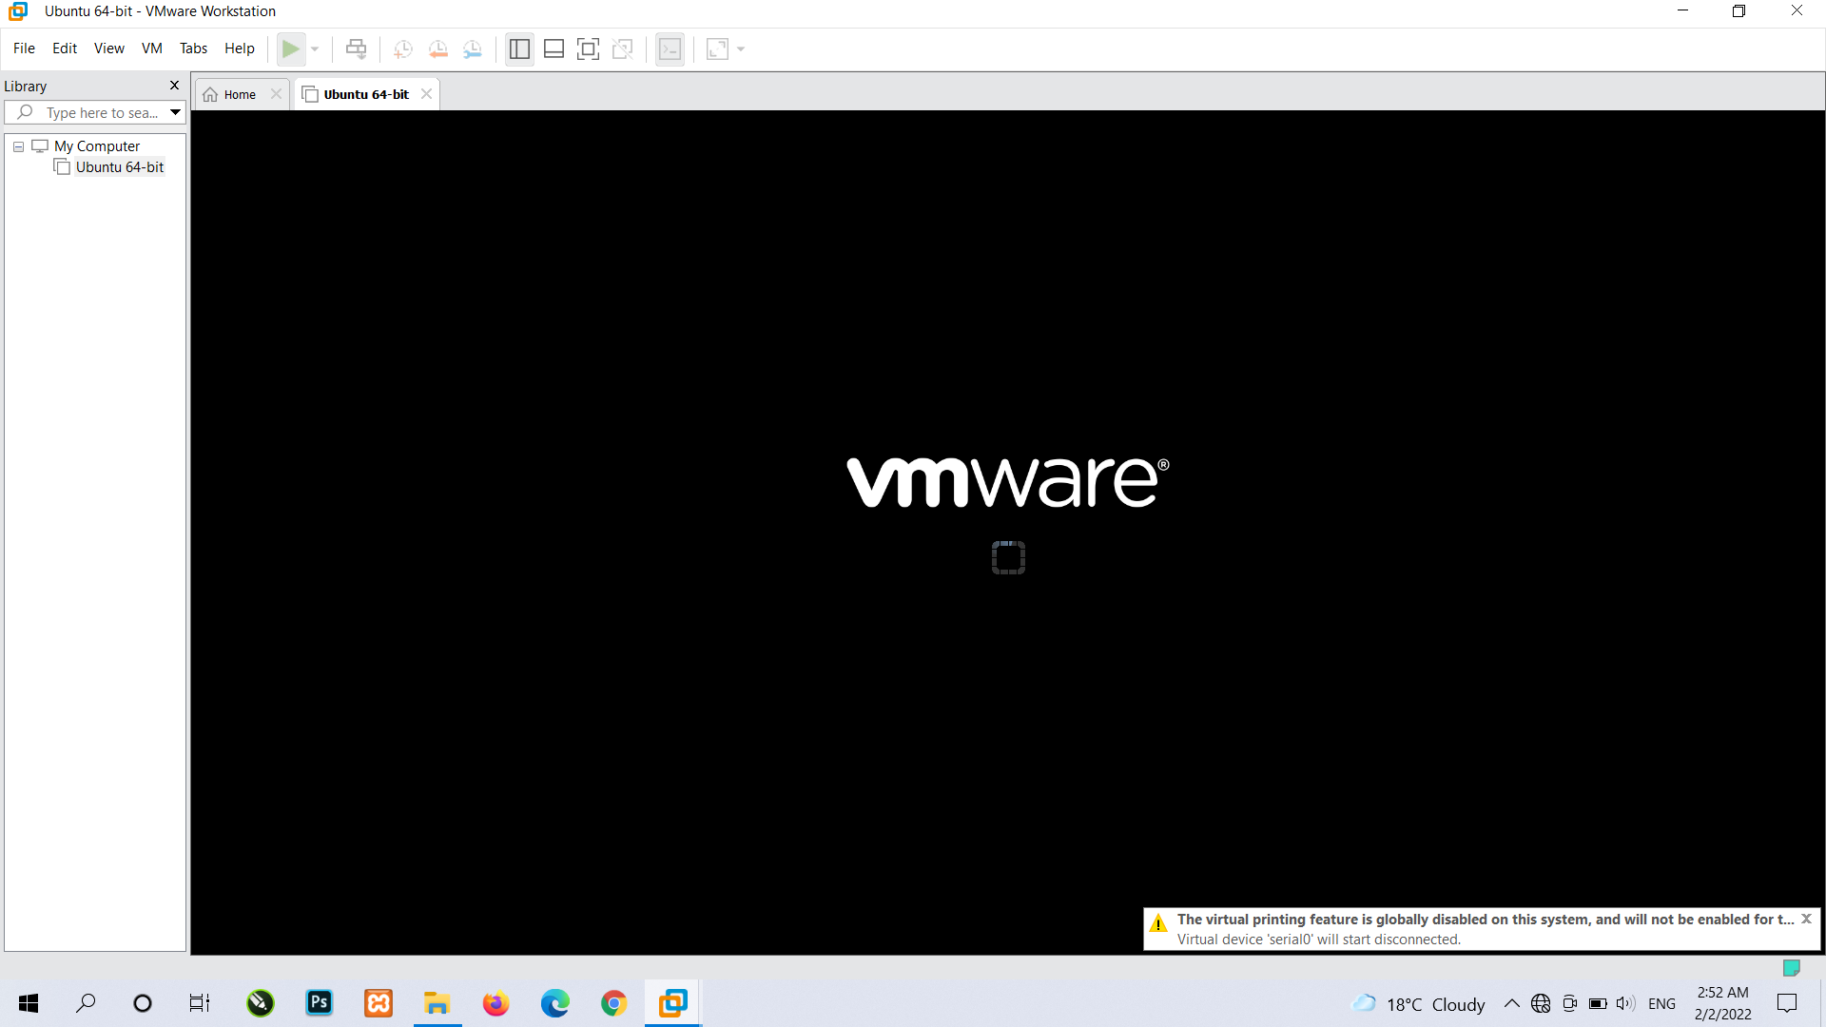

Slide 10
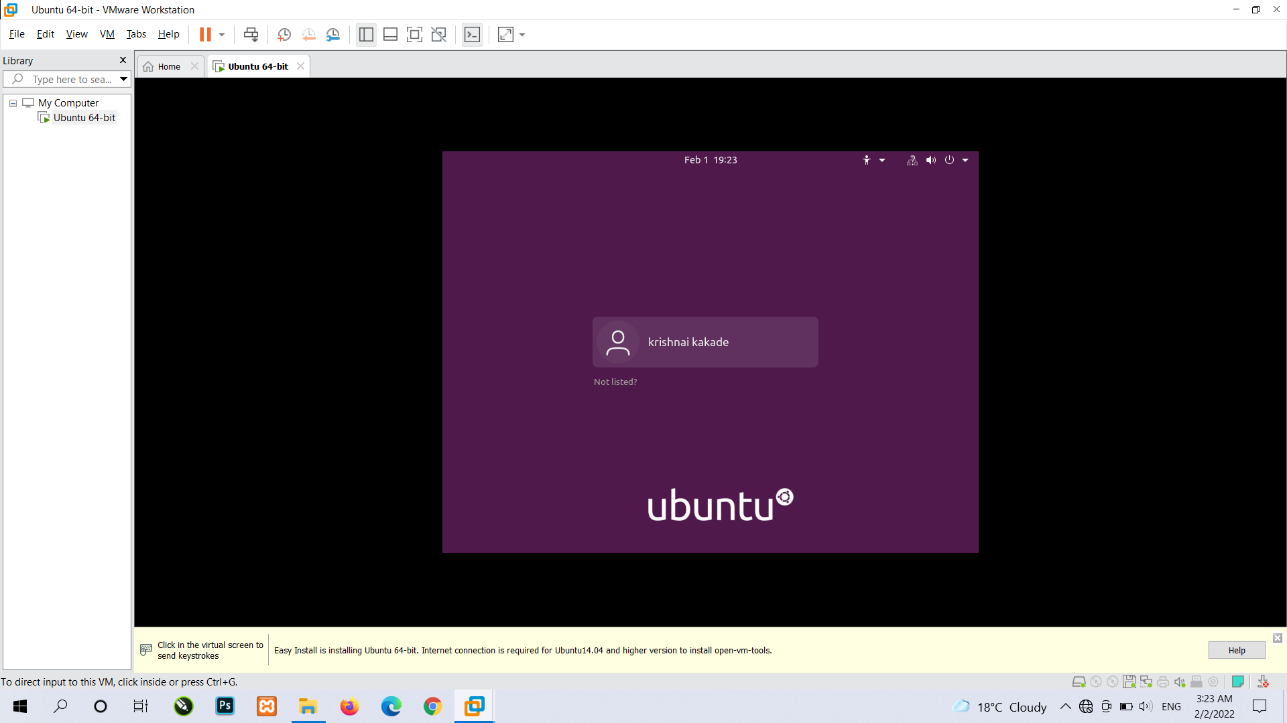

Slide 11
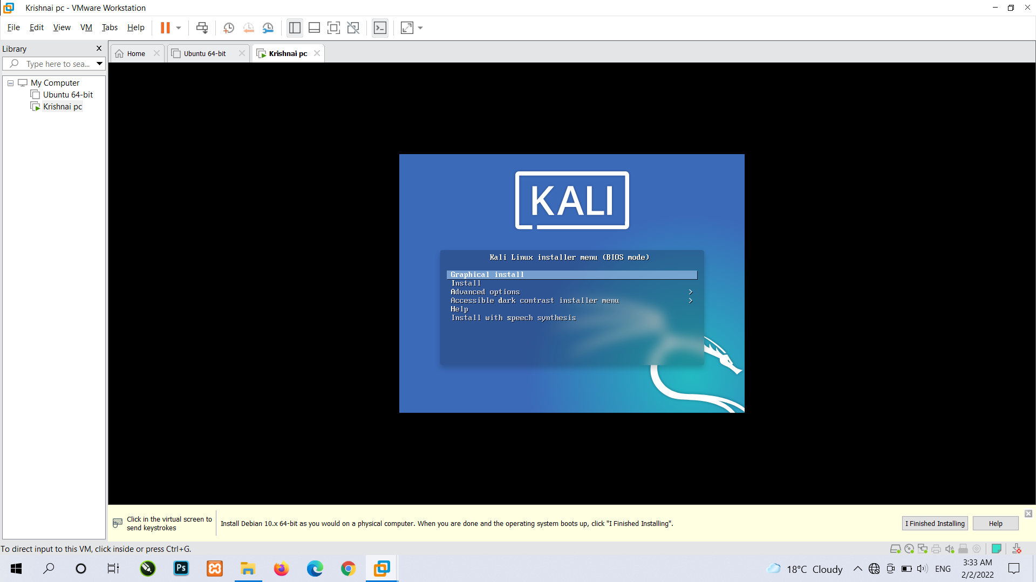
Installation of Kali Linux 1. click on create new virtual machine then follow same instruction as when you was downloaded ubuntu in Vmware. 2. then choose first option.

Slide 12
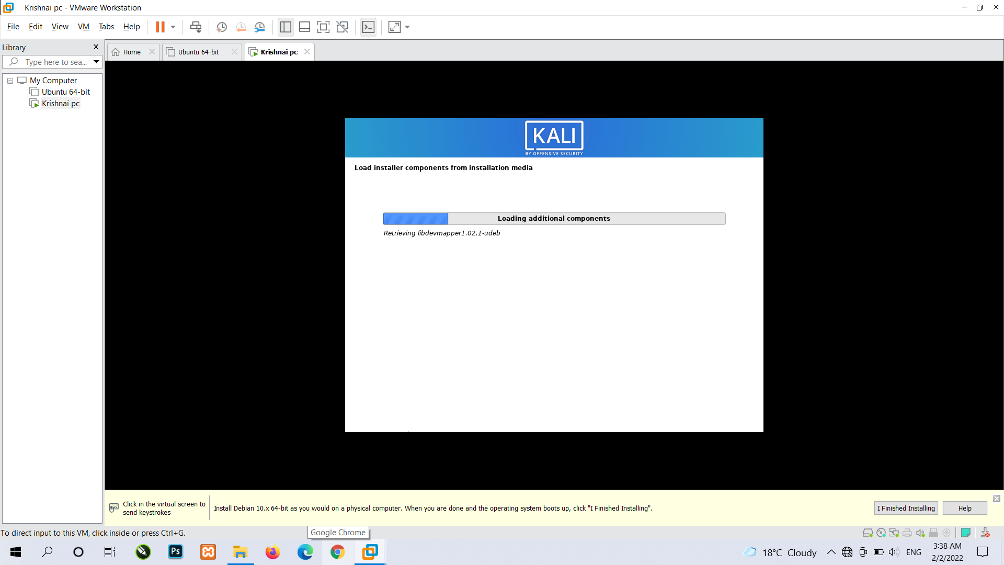

Slide 13
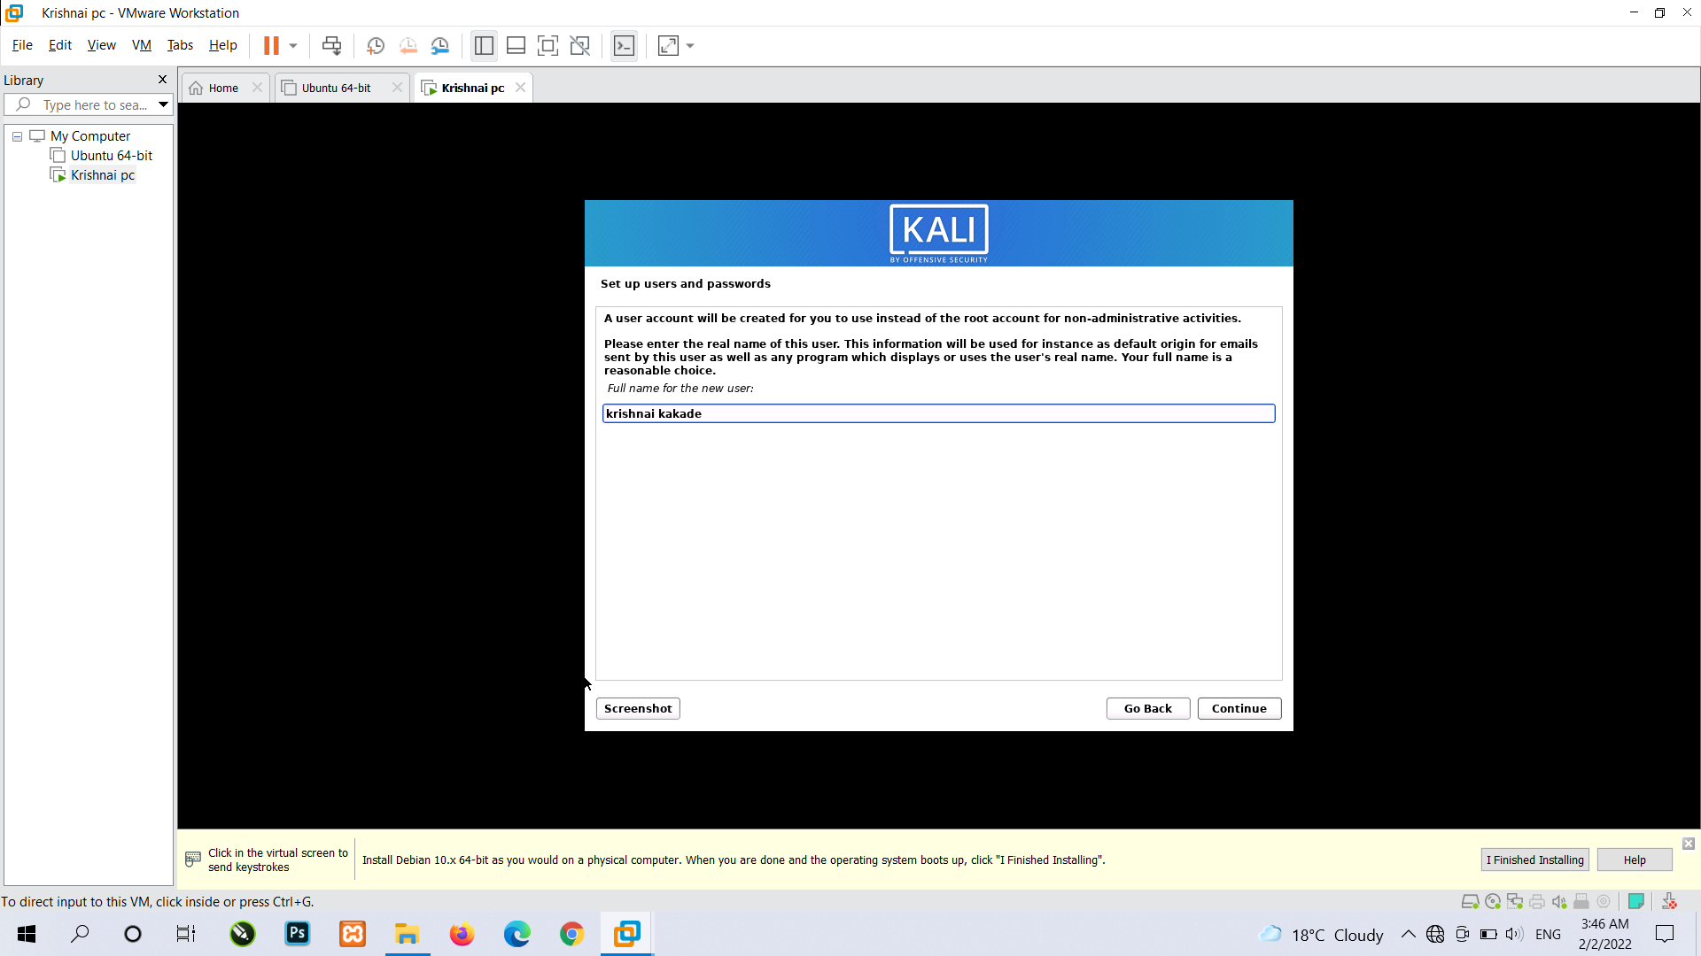

Slide 14
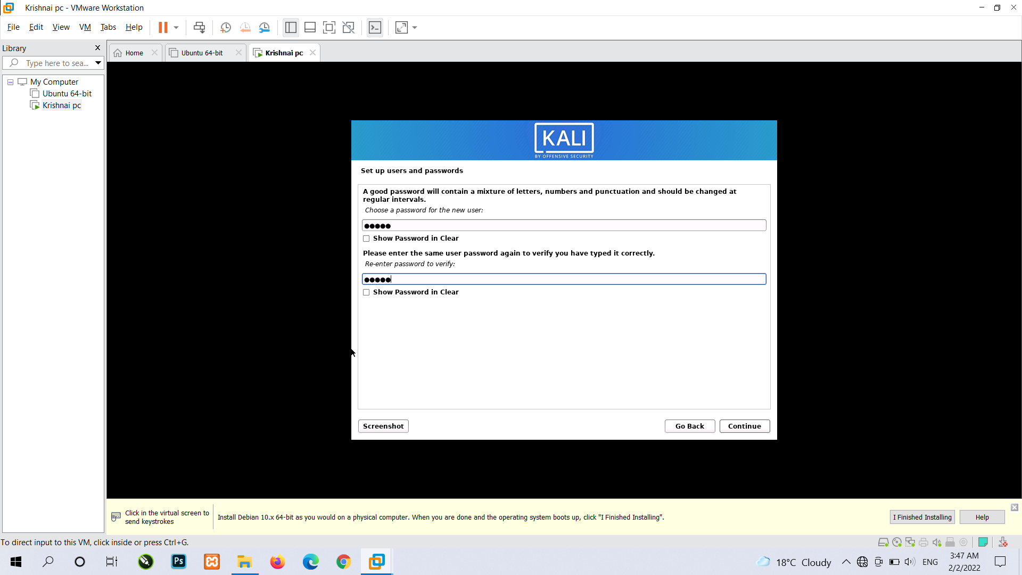
You have to give password then click on continue

Slide 15
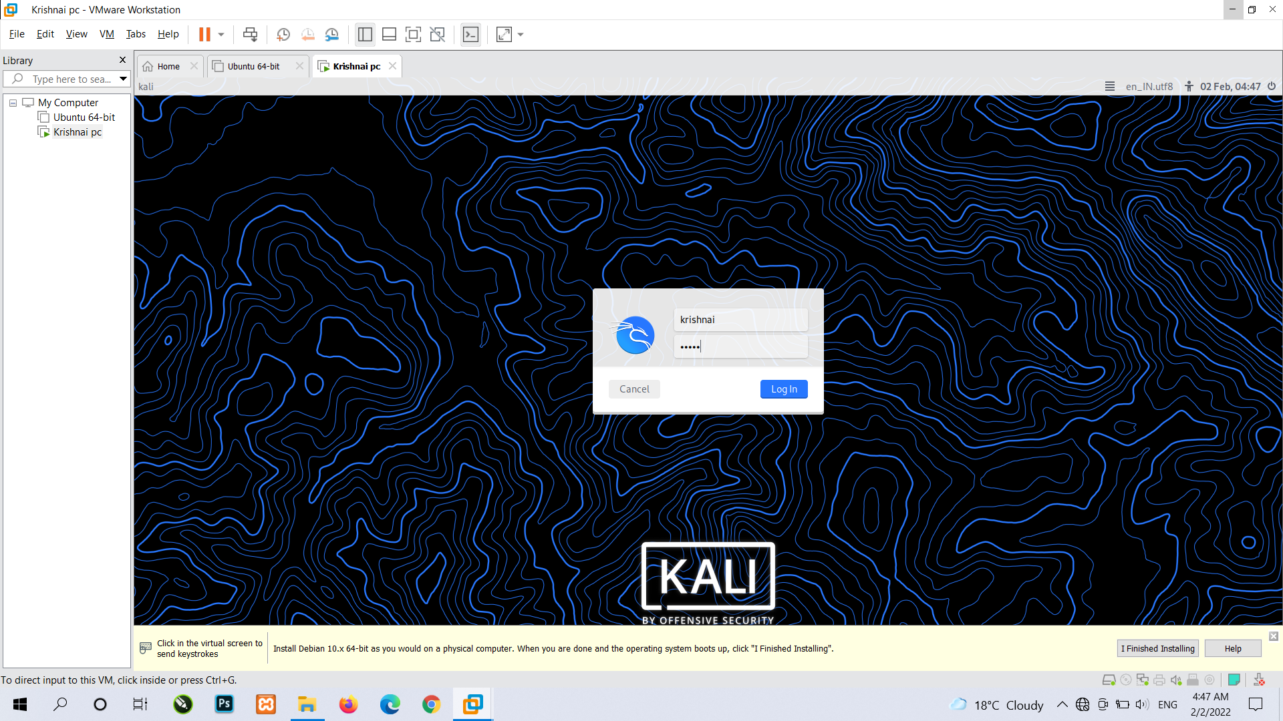

Slide 16
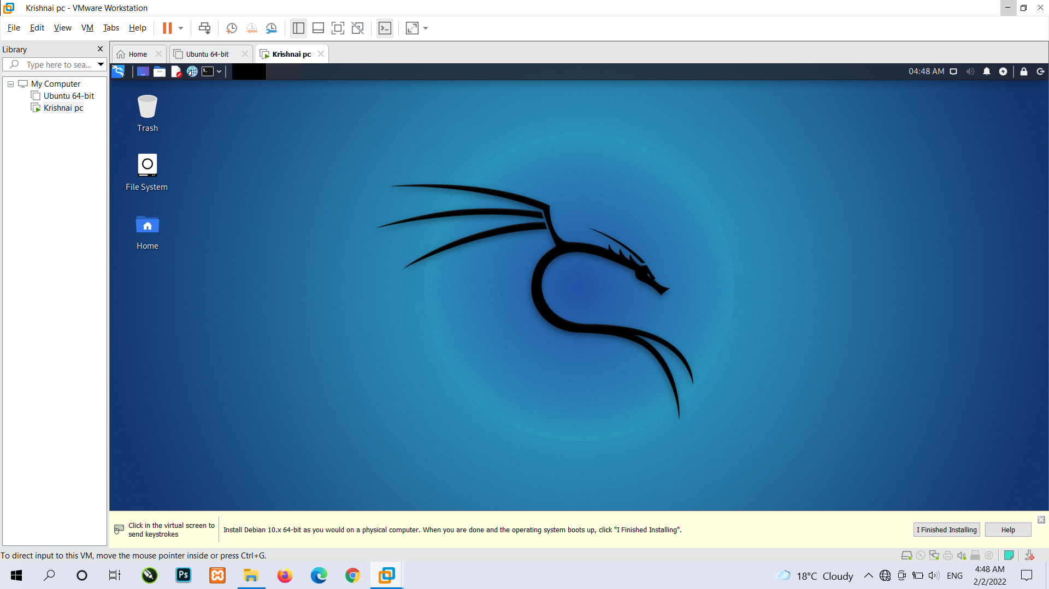

Slide 17
NAT Networking (Network Address Translation)
To access the Internet, one public IP address is needed, but we can use a private IP address in our private network. The idea of NAT is to allow multiple devices to access the Internet through a single public address.
To achieve this, the translation of a private IP address to a public IP address is required. Network Address Translation (NAT) is a process in which one or more local IP address is translated into one or more Global IP address and vice versa in order to provide Internet access to the local hosts.
Also, it does the translation of port numbers i.e. masks the port number of the host with another port number, in the packet that will be routed to the destination. It then makes the corresponding entries of IP address and port number in the NAT table. NAT generally operates on a router or firewall.

Slide 18
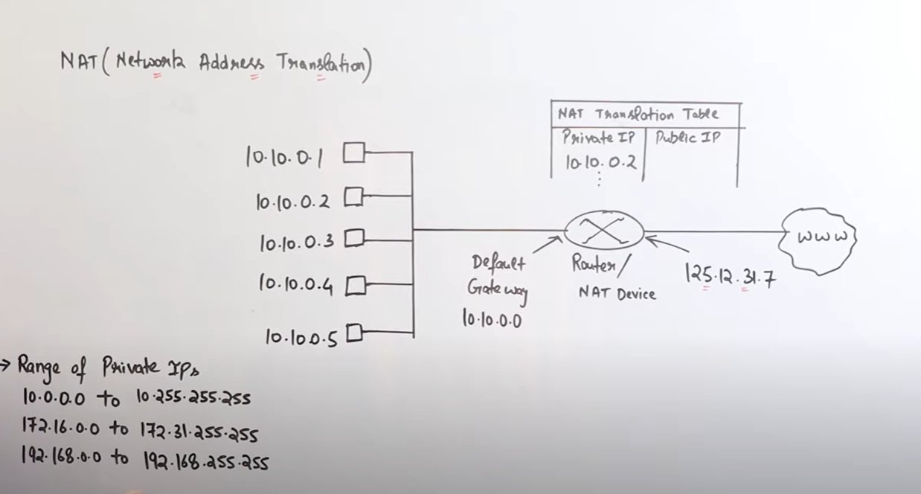

Slide 19
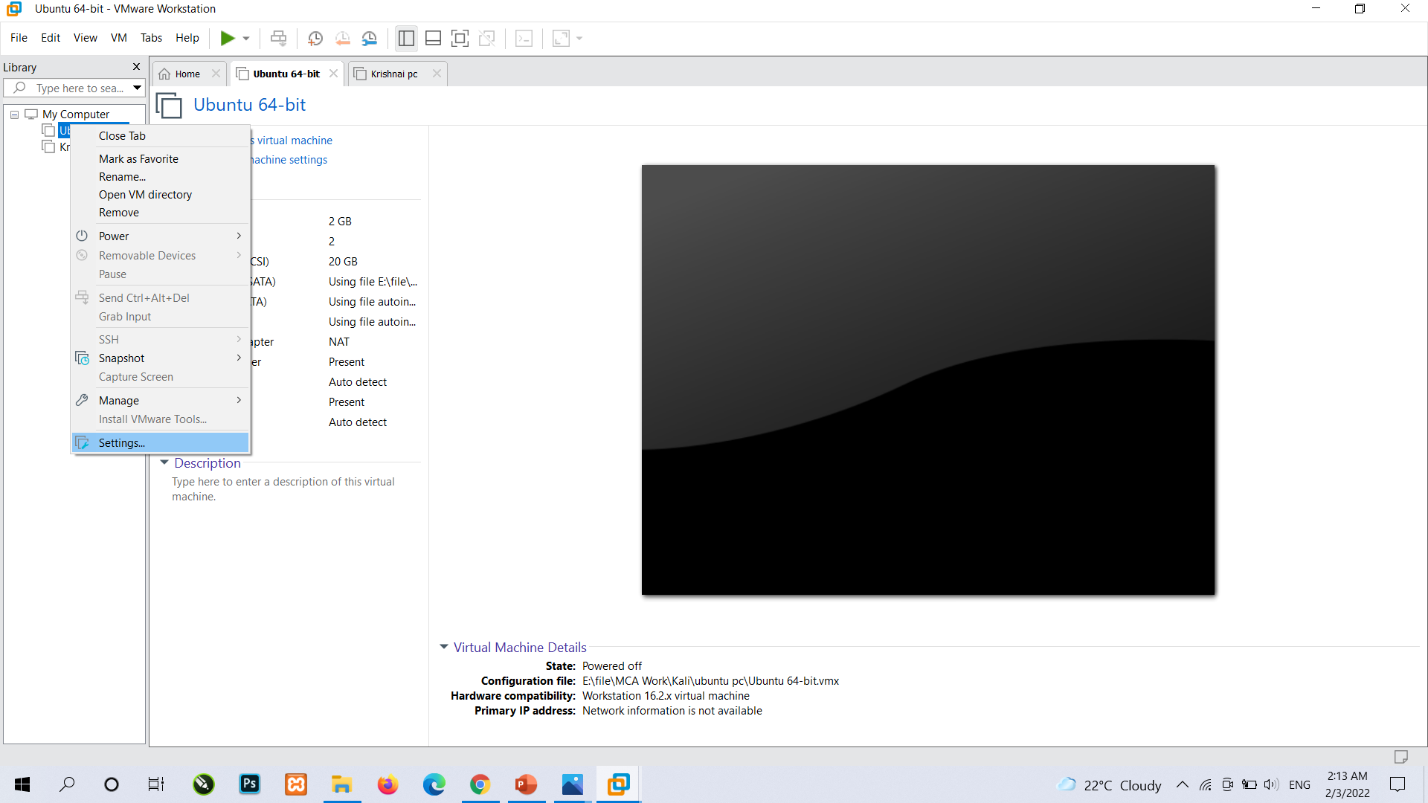
1. Right Click on ubuntu then there is settings option NAT networking is already selected by default in ubuntu and in kali linux

Slide 20
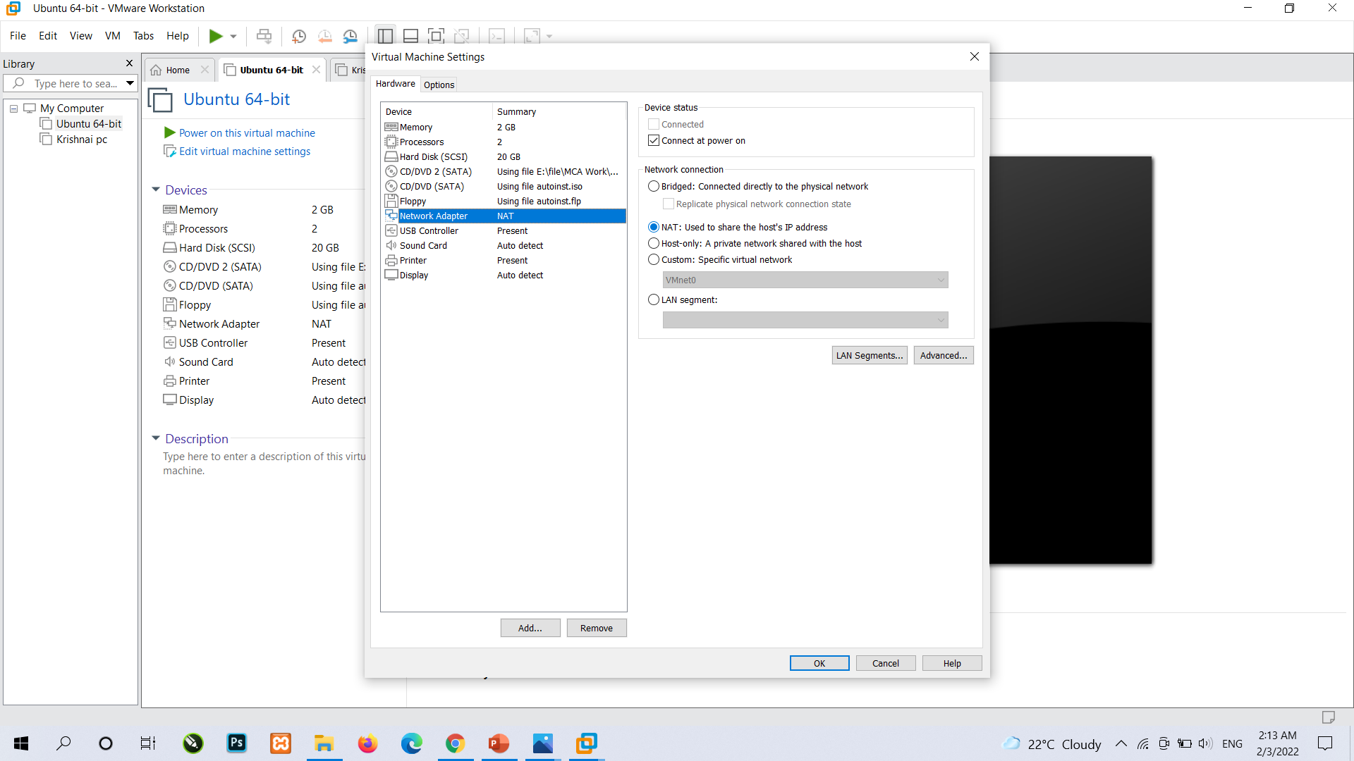

Slide 21
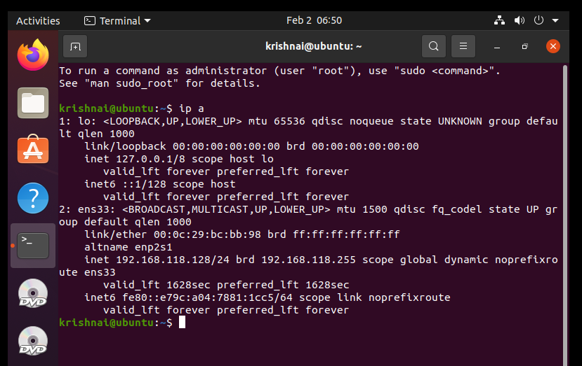
After that to see IP address type a command in terminal ip a as you can see ubuntu operating systems ip address is 192.168.118.128/24 /24 is subnet mask In IPv4, these subnet masks are used to differentiate the network number and host identifier.

Slide 22
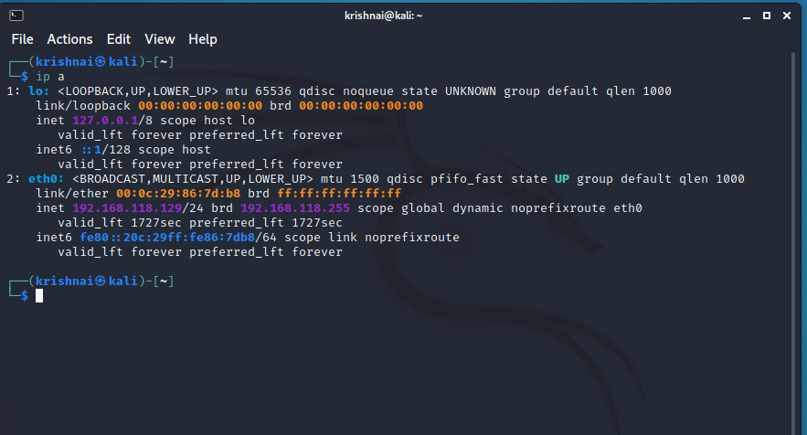
Kali Linux operating systems ip address is 192.168.118.129/24

Slide 23
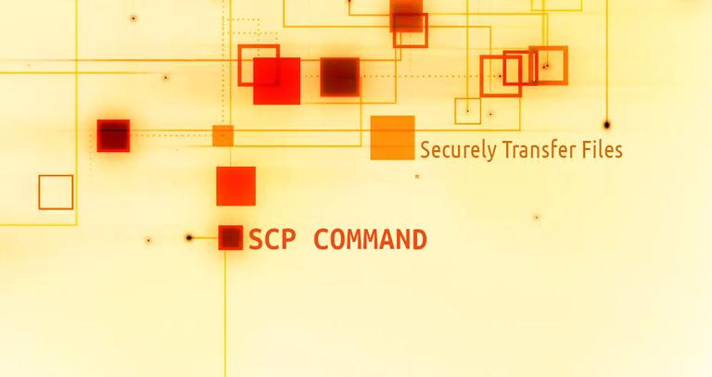
SCP (secure copy) is a command-line utility that allows you to securely copy files and directories between two locations.

Slide 24
How to Use SCP Command to Securely Transfer Files With SCP, you can copy a file or directory: From your local system to a remote system. From a remote system to your local system. Between two remote systems from your local system. SCP Command Syntax scp file.txt remote_username@10.10.0.2:/remote/directory

Slide 25
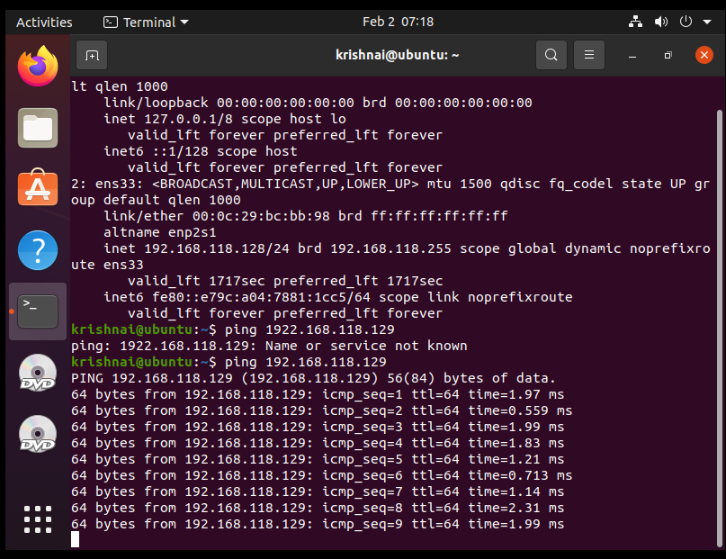
Type ping and ip address so other machine will give respone

Slide 26
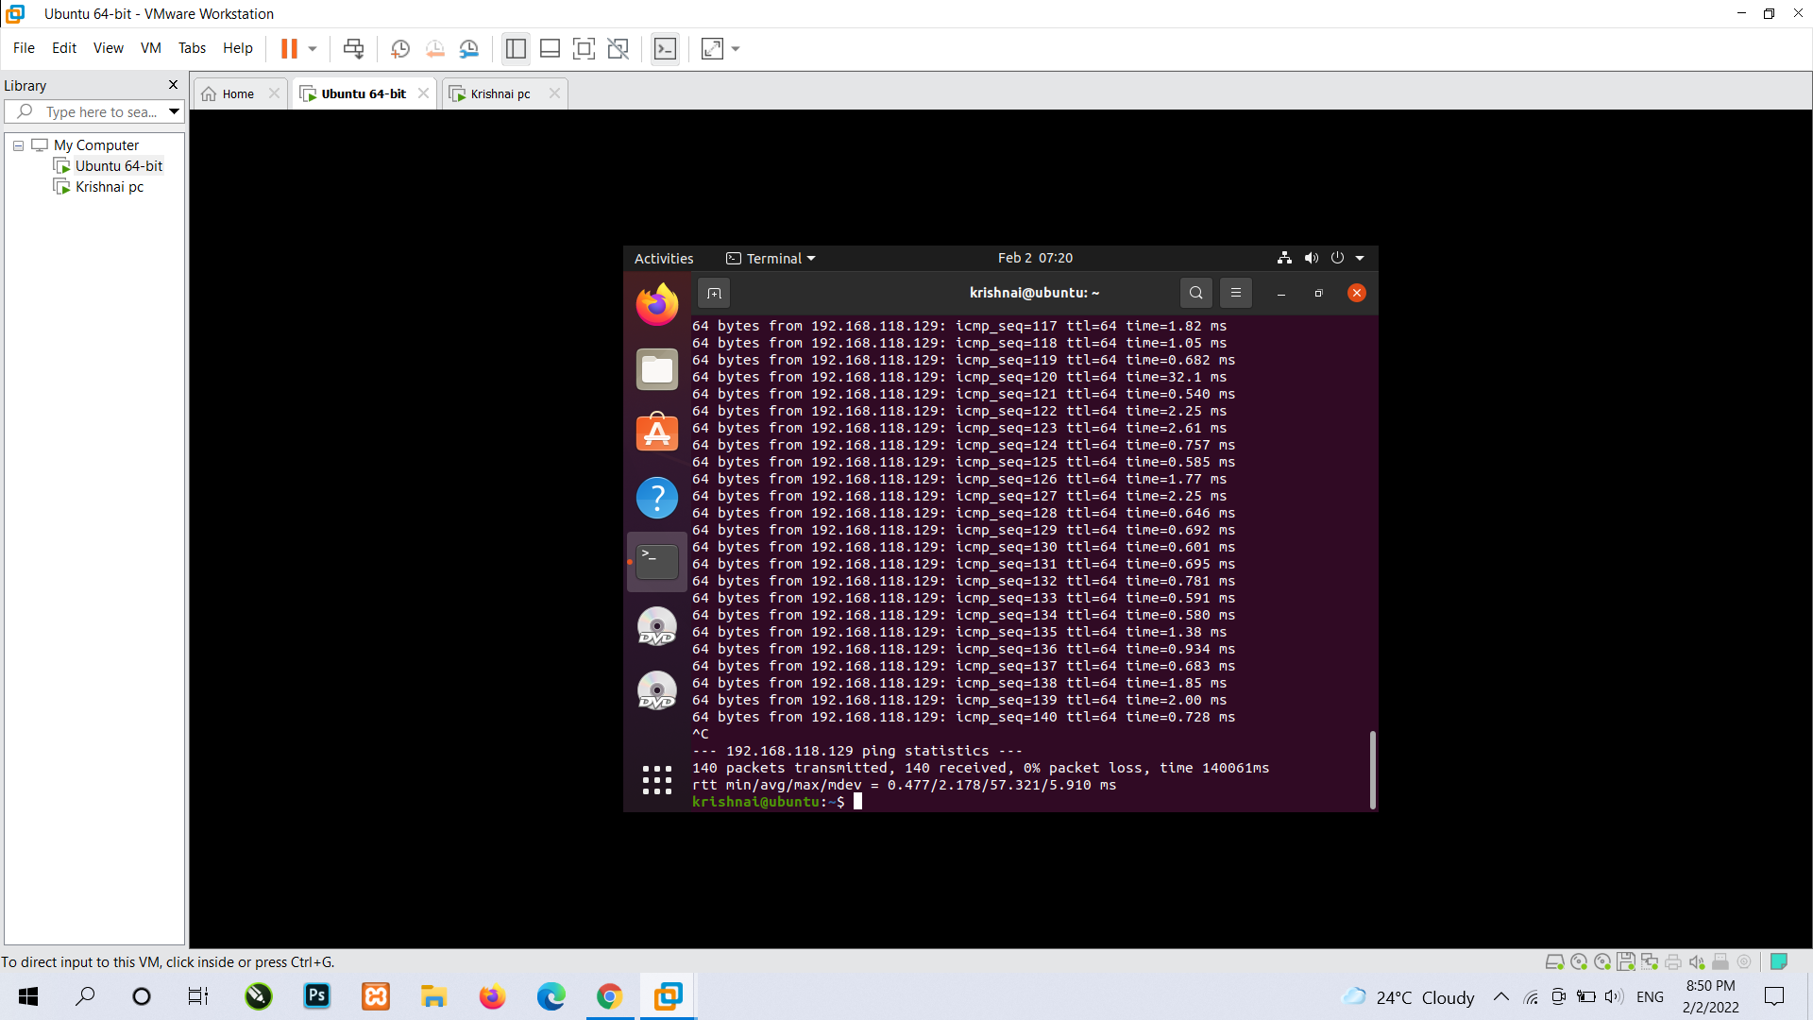

Slide 27
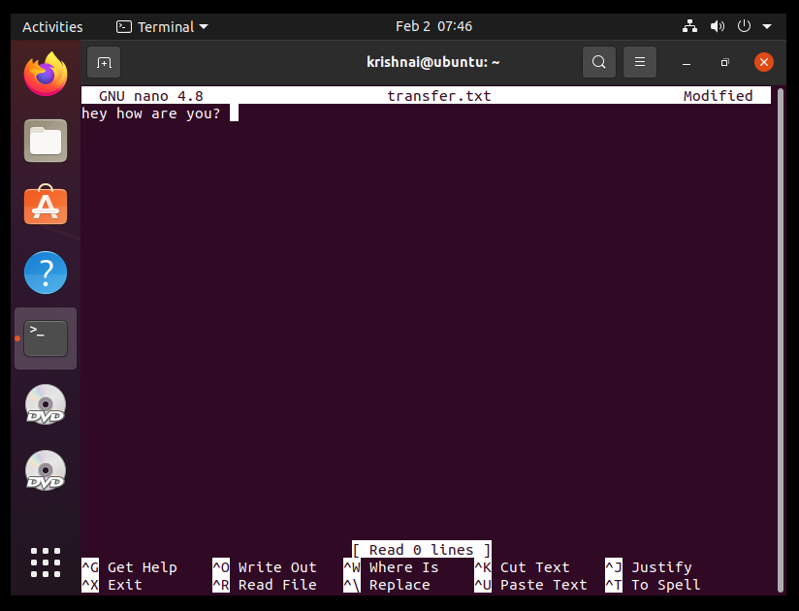
We wants to send file for that create a file type a command touch (it will make new file) with file name then file will create after that in that type command nano (it will open editor) and file name then editor will open in that type whatever message you wants to transfer. So my file name is transfer.txt

Slide 28
- SSH, also known as Secure Shell or Secure Socket Shell, is a network protocol that gives users, particularly system administrators, a secure way to access a computer over an unsecured network. - SSH also refers to the suite of utilities that implement the SSH protocol. Secure Shell provides strong password authentication and public key authentication, as well as encrypted data communications between two computers connecting over an open network, such as the internet.
1. if SSH is not install in your device and you wants to know its installed or not simply type SSH command in your terminal.
2. If there are some errors type a command
- Sudo apt-get install ssh
3. after that type ssh localhost
- It will ask password of that machine
- If you are getting errors in this command type
- Ssh apt-get install openssh-service command

Slide 29
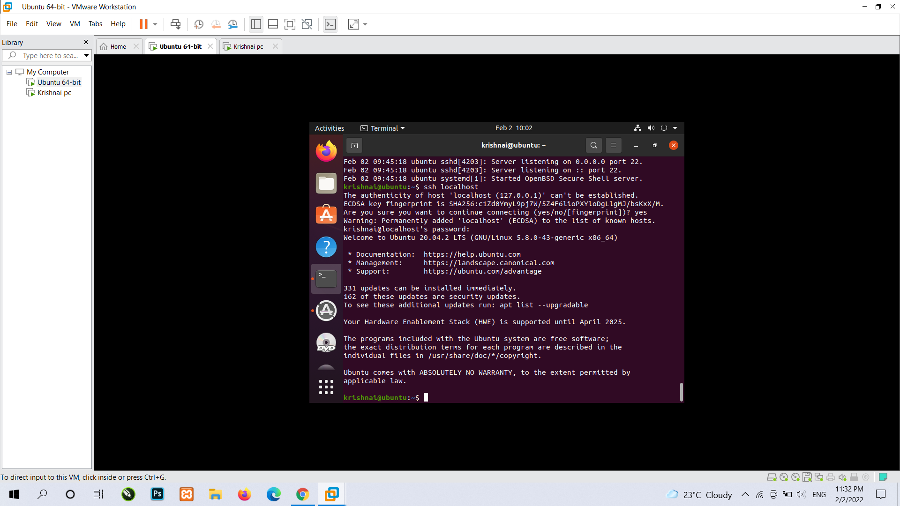

Slide 30
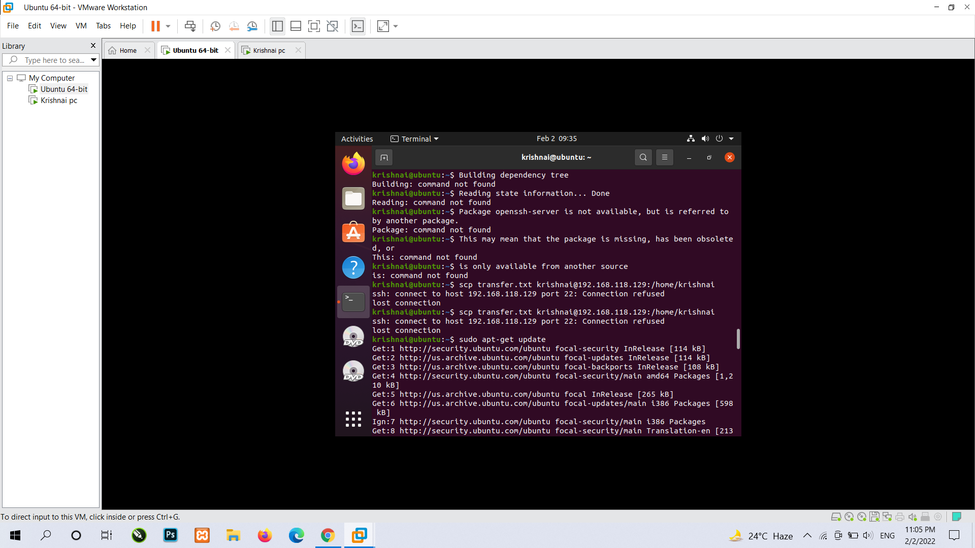

Slide 31
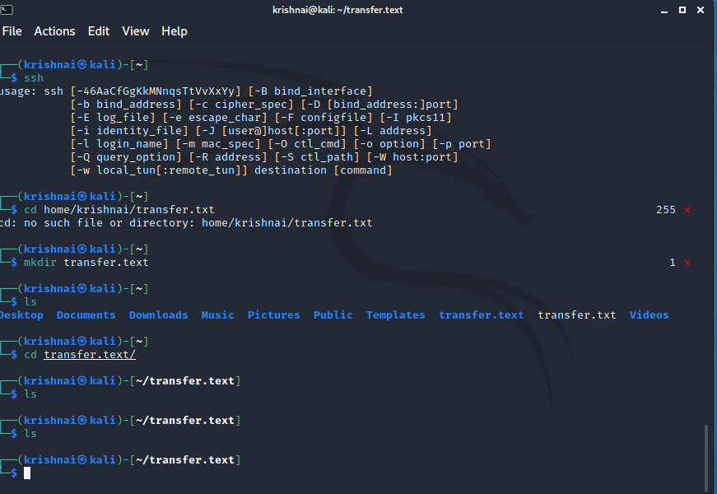
If you are getting errors then do same process with second machine like I did in kali linux

Slide 32
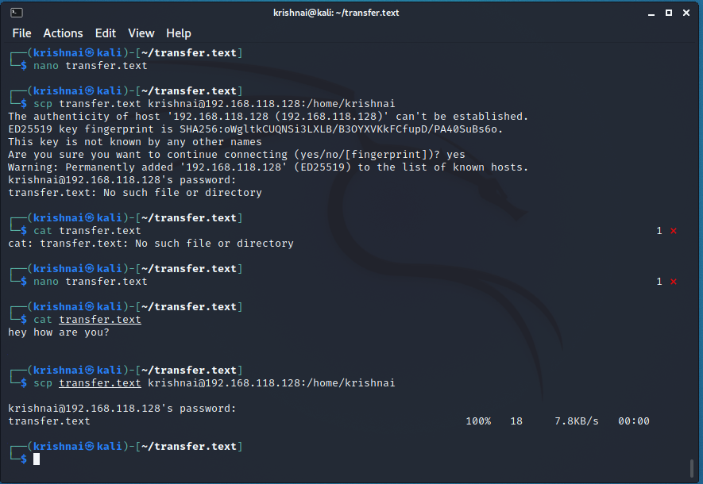
After that Type this command to transfer file scp file.txt remote_username@10.10.0.2:/remote/directory

Slide 33
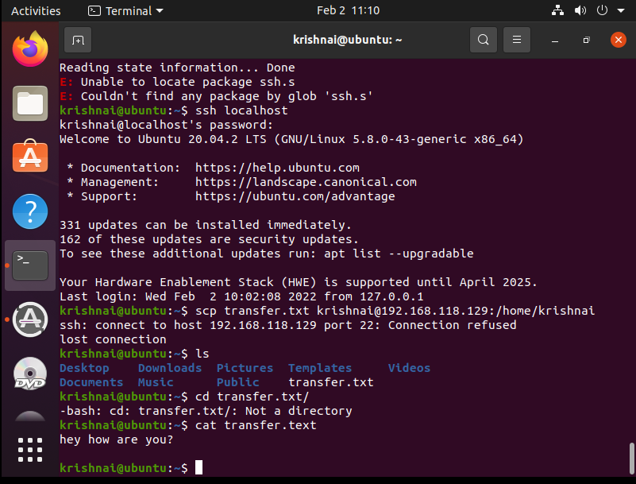

Slide 34
Thank you

